Slide 1

WEB SOCKETING - A HANDSHAKE TO TODAY'S COMMUNICATION
Fireside 26’
Arjun D Kumar 29.1.2026
Habibi ket

Slide 2

Hmmm , whats a websocket!?
In theory , Websockets are used in systems , where we need to display data in real time and with low latency , what kind of systems are these used , well u could say in things like a chat application (like whatsapp and instagram) , game leaderboard..basically anything which needs a constant communication between a user/client and a server!
(i too had the same reaction as catto!)

Slide 3
HTTP : HYPERTEXT TRANSFER PROTOCOL?? tcp!!???
http stands for hypertext transfer protocol , popularly called as the language of the web . Its basically a request response protocol that allows two clients/server to talk over the internet! TCP : Transmission Control Protocol , which basically breaks down your request into bits n pieces and transmits them across between the client and server!
Now , coming back to HTTP , what HTTP basically did was , anytime a client or a user needed to communicate , they were required to open a TCP Connection request, think it of like you extending your hand to your friend for a dap , and once your friend recognizes that and extends his hands too , and "DHUPPPPPP" a handshake!
client
server

Slide 4
The catch! And the fix : http 1.1 !
The Catch: the issue was that immediately after a single req-res cycle , the tcp connection would close , which meant that for sending another message you would have to initiate another handshake again! On a larger scale , imagine sending 4 photos to your friends , that would mean initiating a handshake almost 4 times! very time consuming and less efficient!
client
server

Slide 5
The fix !
The Fix : To fix this , HTTP 1.1 was introduced , where there was the inclusion of "Connection : keep alive" which did exactly as it said lol , it kept the connection alive , as long as the client and the server kept their communication ON , multiple req res could be made during this session until one of them terminated the hand shake!
client
server

Slide 6
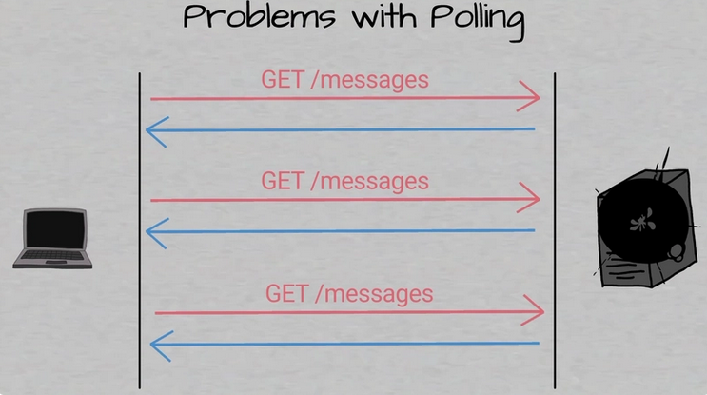
Http 1.1 : a solution or new problem?
Even with HTTP 1.1 creating web applications that needed two way communication , required us to have a total abuse of HTTP , abuse as in what form?
Polling , or in more depth , short and long polling:
Short polling , in short words was client/server sending a request every fixed intervals , say every 2s there's a req , with the client going "hey u got any messages" the server going "nope buddy" , again after 2s , client: hey u got messages? , server : nope , again after 2s....and this went on , quite the hassle as it wasted a lot of data , since ur for no reason sending in a req every 2s and the server saying nah every 2s lol
Long Polling: now instead of the client going "got any new messages" constantly every 2s , it would send a request and ........(cricket noises)..........20s(one eternity later) server : oh here's your response , to which the client sends yet another request just to wait again .... unnecessarily kept the server on

Slide 7
Web sockets (yes finally lol)
The WebSocket makes it possible to open a two-way interactive communication session between the user's browser and a server. Websocket is like asking ur friend to bunk "hey will bunk uh?" , say less bruv!
each communication in http takes huge packets of data , a single req res takes probably 1000s and 1000s of bytes
websocket has something called frames which cuts off the unnecessary Requesting my friend to bunk , into a 2 byte req-res communication HTTP servers can't exactly reply , not until you ask for it , on the other hand , two way communication is much easier on websocket as something from the server is immediately sent to you!

Slide 8
Websocket frames
What's a frame? mm , so Frame is let's say , tiny packages of data - now what kinds of data....
1st your message but in binary or other format
2nd a secret translator or opcode , which your tells your receiver how to translate this data to what it actually is!
now you have a control frame and a data frame...simple , data frames are literally the data u send in , and control frames are basically pingpong n close , close closes the connection , ping checks and pong replies to a ping

Slide 9
WEBSOCKET APPLICATIONS!
Starting from the basic:
a chat application
game servers
live stocks
updates server
think outside the box : a online drawing application for all of us to paint our canvas together!
an online book reading application for all of us to read together and get into the depths of the lore together with bookmarks n what not!

Slide 10
Websockets! - how to use them in my project!
Client.js const socket = new WebSocket('ws://localhost:8080');
Here we are basically calling the inbuilt websocket into a given URL Post the connection we use
Onopen - displays a text on open
Onmessage - server sends a msg to the user
Onerror - displays error
onclose. - displays a text on close Nice Tea : websockets!
Server.js const WebSocket = require('ws');
const server = new WebSocket.Server({port:8080});
Here we are calling the “ws” the websocket library along with starting the server port to handle requests! Following which we use .on , .send commands to communicate

Slide 11
WEBRTC AND SOCKET.IO - BASE TO CHAT-APP AND JAMSESH
Webrtc :JamSesh is a real-time, multi-device audio streaming app built with WebRTC. One device acts as the master and streams audio, while other devices as clients can join at any time and hear the same audio in perfect sync whether in the same room (to create a speaker-like effect) or across the internet. The core focus is on achieving minimal latency for a seamless, synchronized listening experience. Socket.io : It is a library that uses and is based off of websockets , say socketio is a luxury car and the engine for it is websockets! WebRTC and Socket.IO are both real-time technologies but serve different purposes: WebRTC enables direct peer-to-peer (P2P) audio/video/data streaming with ultra-low latency, while Socket.IO (built on WebSockets) provides reliable, bidirectional, client-server communication. WebRTC is ideal for video conferencing, while Socket.IO excels at chat apps or collaborative tools

Slide 12
THANK YOUUUUUUUUUUU
Shhh……checkThisOut

